Slide 1
Cardiovascular Disease Prediction
Team Details
Mentor
Ravi Shankar A V
Tintu B John
Abdul Rahman P J
Baskar D
Febin Thomas
Vibha Santhanam

Slide 2
Problem Definition
Heart disease is one of the leading causes of death for people in our country. Public health estimates indicate that India accounts for approximately 60% of the world's heart disease burden.
About half of all Indians have at least 1 of 3 key risk factors for heart disease: high blood pressure, high cholesterol, and smoking. Other key indicator includes diabetic status, obesity (high BMI), not getting enough physical activity or drinking too much alcohol.
We need a system to predict a patient's hearts condition using these factors.

Slide 3
Business Objective
To create a solution for predicting a patient’s heart condition using the key indicators from the acquired data.
Approach
Build a machine learning model to accurately detect "patterns" from the Key Indicators to predict a patient's heart condition.

Slide 4
EDA
Dataset
The dataset provides us 319796 records with the various factors that lead to Heart Disease such as BMI, Smoking, Alcohol Drinking, Stroke, Physical Health, Mental Health, Diff Walking, Sex, Age Category, Race, Diabetic, Physical Activity, Gen Health, Sleep Time, Asthma, Kidney Disease, Skin Cancer.
The dataset come from the CDC and is a major part of the Behavioral Risk Factor Surveillance System (BRFSS), which conducts annual telephone surveys to gather data on the health status https://www.kaggle.com/datasets/kamilpytlak/personal-key-indicators-of-heart-disease

Slide 5
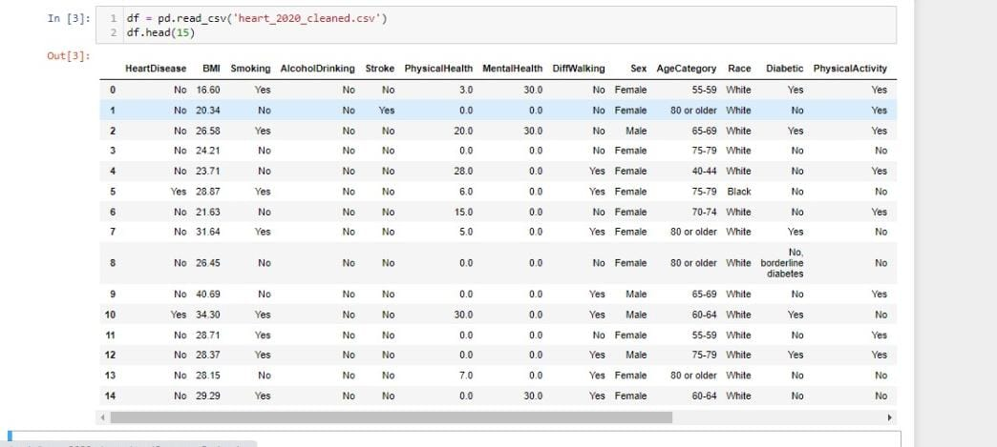

Slide 6
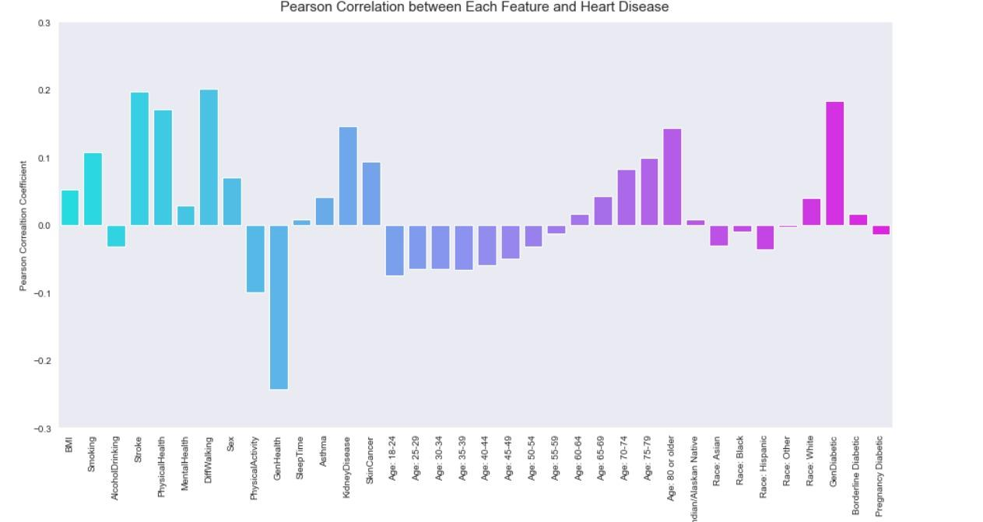
CORRELATION GRAPH

Slide 7
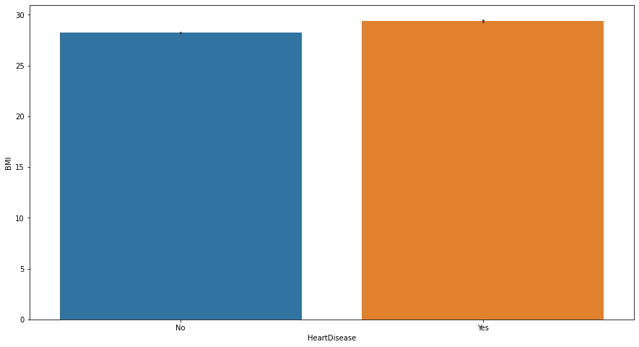
BMI
BMI contributes to heart disease.
People with BMI less than 20 or greater than 25 tend to have a higher chance of getting heart disease.

Slide 8
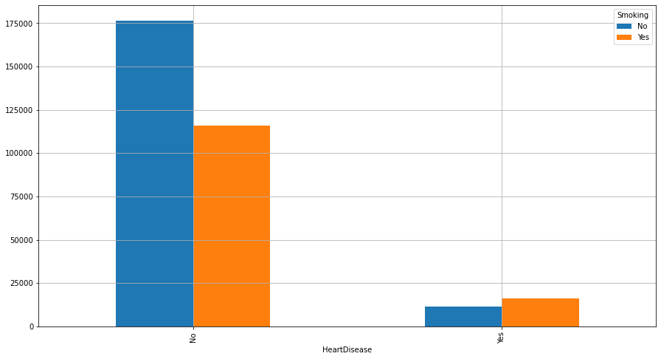
SMOKING
Smoking habits contributes to heart disease.

Slide 9
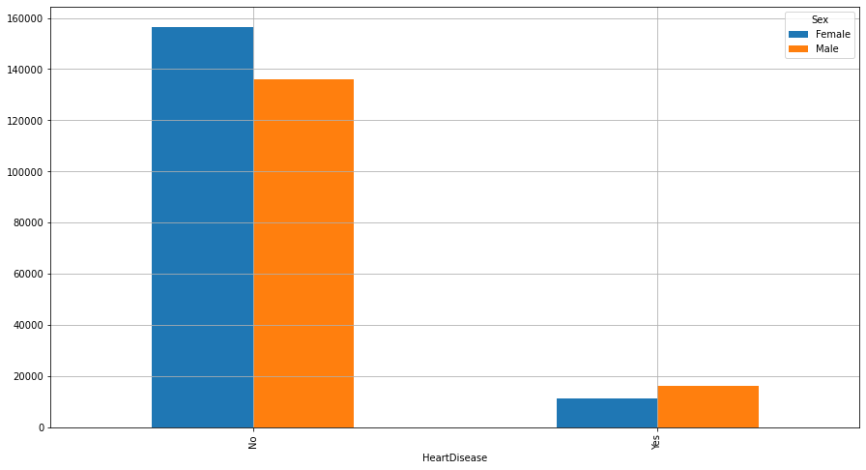
SEX
In terms of sexes, males tend to have a higher chance of heart disease than females.

Slide 10
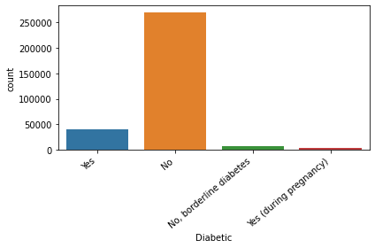
DIABETIC CONDITION

Slide 11
Algorithms
GaussianNB :
Naive Bayes methods are a set of supervised learning algorithms based on applying Bayes’ theorem with the “naive” assumption of conditional independence between every pair of features given the value of the class variable.
Accuracy Score: 0.7619048562107172
Precision Score: 0.22755280407865987
Recall Score: 0.706827261761158
F1-Score: 0.3392097902097902

Slide 12
RandomForestClassifier :
A random forest is a meta estimator that fits a number of decision tree classifiers on various sub-samples of the dataset and uses averaging to improve the predictive accuracy and control over-fitting.
Accuracy Score: 0.8935469412856085
Precision Score: 0.29183806018618746
Recall Score: 0.16260554885404102
F1-Score: 0.20884654117282517

Slide 13
Conclusion
The prediction exhibition of each technique and apply the proposed system for the area it required, The accuracy achieved for Naive Bayes is 76.19% and Random Forest showed 89.35%.

Slide 14
Appendix

Slide 15
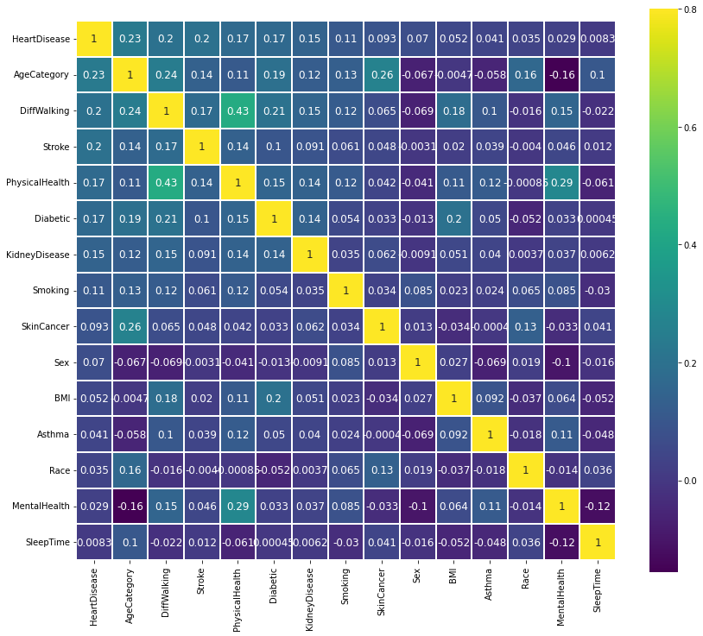
Heatmap

Slide 16
Other Inferences from the data :
Alcoholic drinking habits does not contribute to heart disease, which is quite counter-intuitive.
Stroke contributes to heart disease.
People older than 60 tend to have heart disease than those younger than 60.
Kidney disease and diabetes contribute to heart disease.

Slide 17
The amount of sleep time in a day does not seem to give a considerable contribution to heart disease. However, people without heart disease commonly have a better sleep time, that is about 6 to 8 hours in a day.
Asthma only gives a small contribution.
The amount of sleep time in a day does not seem to give a considerable contribution to heart disease. However, people without heart disease commonly have a better sleep time, that is about 6 to 8 hours in a day.

Slide 18
Thanks!

